Slide 1
Spatial Pyramid Pooling in Deep Convolutional
Networks for Visual Recognition
https://arxiv.org/pdf/1406.4729.pdf
Abhishek Gupta 2016B3A70576P
Nitish Bahl 2016B2A30808P
Rohan Dudeja 2016B4A30516P

Slide 2
Paper’s Gist
Project Repo
https://github.com/bahl24/SpatialPyramidPooling_Keras
The paper introduces a new pooling layer – “Spatial pyramidal Pooling” to eliminate the fixed size requirement of input to CNN.
It generates fixed length representation regardless of image size/scale.
The paper claims that SPP-net boosts the accuracy of a variety of CNN architectures despite their different designs .
Using SPP-net for object detection - The feature maps are computed from the entire image only once, and then pool features in arbitrary regions (sub-images) to generate fixed-length representations for training the detectors.
Their method is many fold time better than existing R-CNN for object detection.

Slide 3
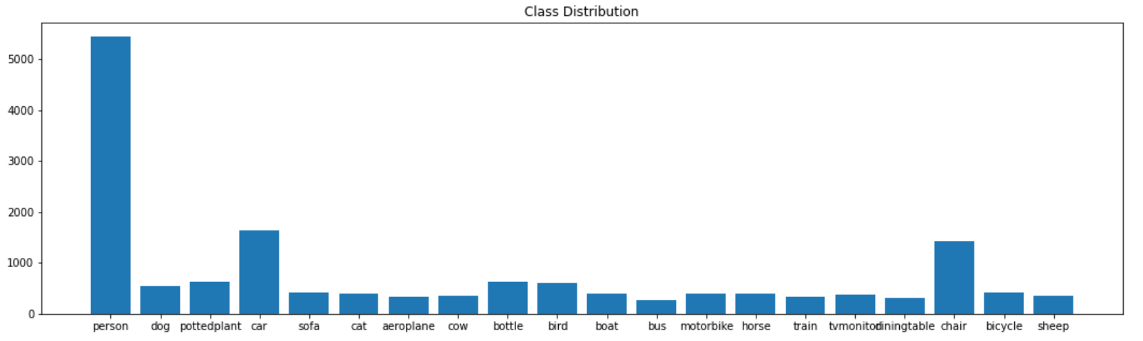
Data
We used PASCAL VOC dataset which consists of 5011 images in total with 120608 objects annotated.
Restructured the jumbled up columns in original data frame consisting object coordinates information
Image data generator was used to
obtain a train/val split of 0.8/0.2.
Class distribution is almost balanced
with a little skewness toward persons

Slide 4
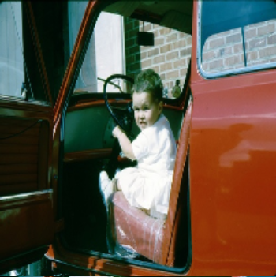
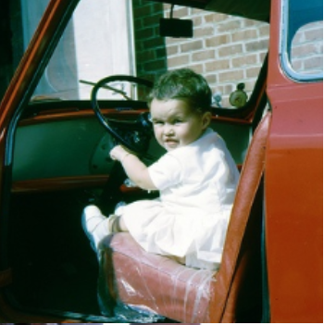
Data Preprocessing
Resizing and Cropping maintaining same aspect ratio.
Fig 1:
Resizing directly to 224x224 from 333x500
Fig 2:
Resized to min(w,h) = 256 and other dimension acc. to aspect ratio.
Then cropping middle 224x224 portion
Data augmentation :
Horizontal flipping
Zoom range from 0.8 to 1.2

Slide 5
C
L
A
S
S
I
F
I
C
A
T
I
O
N
Model
Alex Net is used as base model and SPP-net layer is added on top of that model.
Multi-level (4 levels) pyramidal pooling layer was added after final convolution layers.
Dropout layer were added with prob = 0.2 for fully connected layers which are not a part of vanilla- Alex Net.
Further changes that were not suggested in paper:
1. Batch Normalization was added to make network in- sensitive of random weight initialization .
2. Sigmoid Activation function was used instead of standard soft-max function because the problem was multi-label classification which further improved final results.

Slide 6
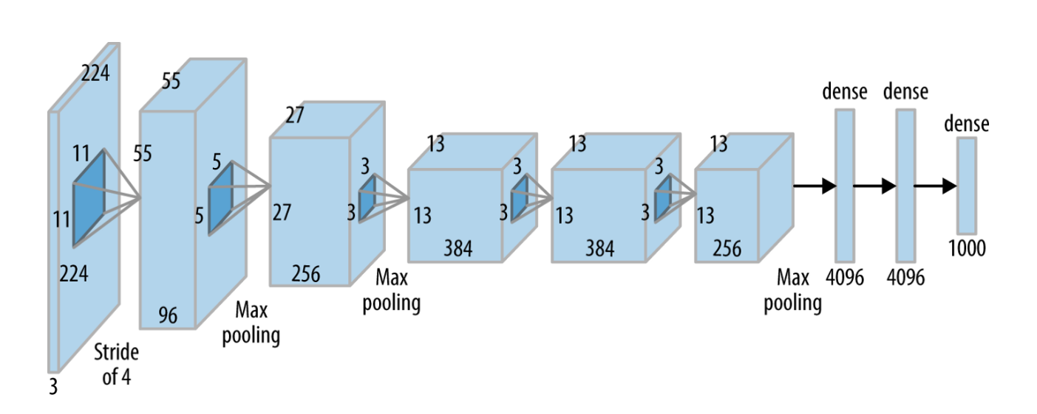
C
L
A
S
S
I
F
I
C
A
T
I
O
N
Model
Dropout (0.2)
20
SPP-Layer
Batch
Normalization
Batch
Normalization
Batch
Normalization
Batch
Normalization

Slide 7
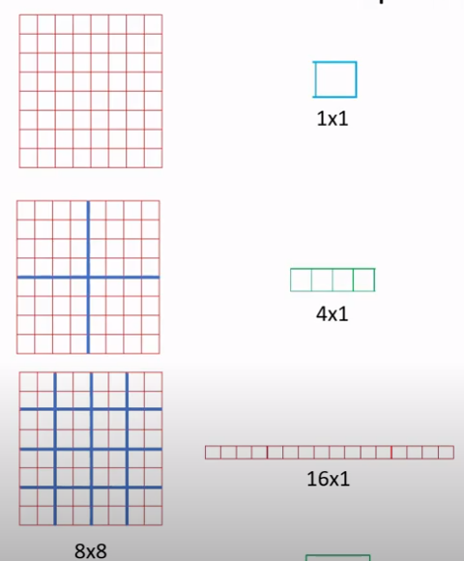
C
L
A
S
S
I
F
I
C
A
T
I
O
N
SPP Layer
For the pyramid level of nxn and feature maps axa, pooling level is implemented using sliding window pooling where
Window size = ceil(a/n)
Stride = floor(a/n)
We implemented multi-level pooling of 1x1,2x2,4x4,6x6 sizes which were concatenated and fed to fully connected layers.

Slide 8
C
L
A
S
S
I
F
I
C
A
T
I
O
N
Results
We used SGD optimizer with learning rate 0.01 and decay factor 1e-6 and momentum 0.9.
No of epochs = 1000 and used early stopping to prevent overfitting.
Model | Train Accuracy | Test Accuracy
No-spp | 55.50 | 41.50
1x1 pool | 48.55 | 43.15
1x1, 2x2 pool | 55.48 | 42.51
1x1,2x2,4x4 pool | 50.48 | 38.48
1x1,2x2,4x4,6x6 pool | 75.13 | 37.00

Slide 9
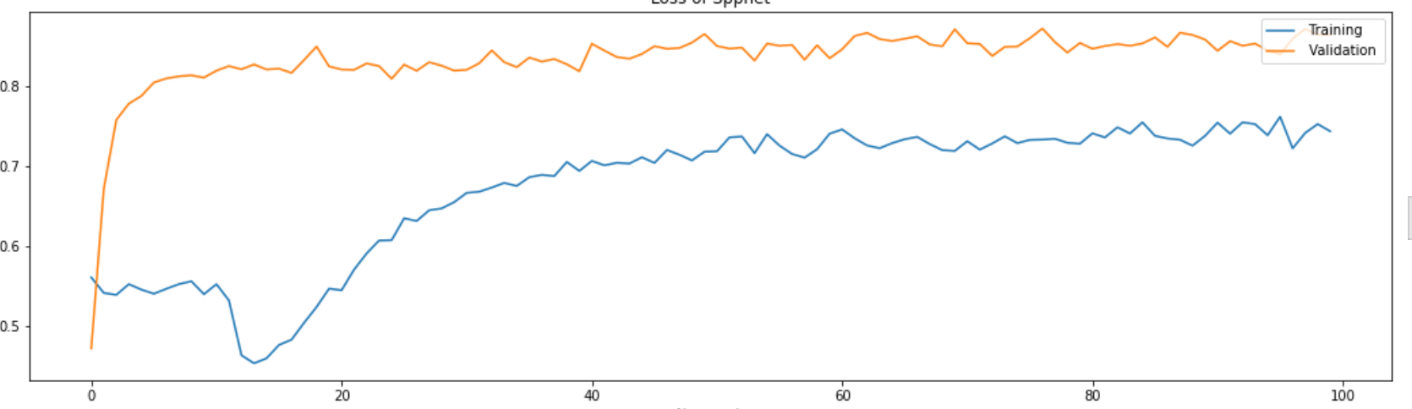
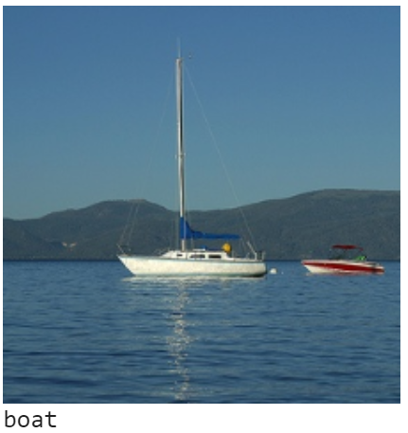
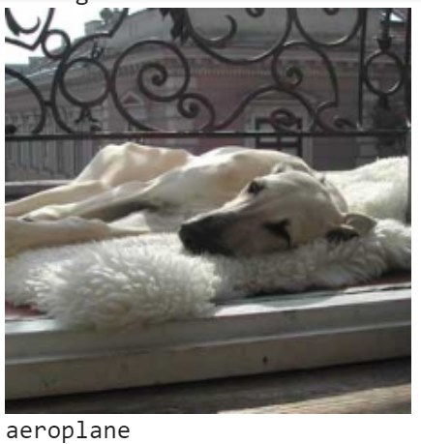
C
L
A
S
S
I
F
I
C
A
T
I
O
N
Results
Correct Classification
of Boat as Boat
Incorrect Classification
Of Dog as Airplane

Slide 10
O
B
J
E
C
T
D
E
T
E
C
T
I
O
N
Model conceptualization
This paper was major breakthrough in field of object detection.
It is a huge improvement in terms of time as well as in accuracy over its predecessor RCNN.
R-CNN first extracts about 2,000 candidate windows from each image via selective search. Then the image region in each window is warped to a fixed size (227x227).
Major bottle neck was that each of 2000 region proposals used to pass through CNN which consumes a lot of time.
But they restructured it and obtained features only once by passing through CNN and then applied SPP-net on each region proposals to obtain fixed length representation.

Slide 11
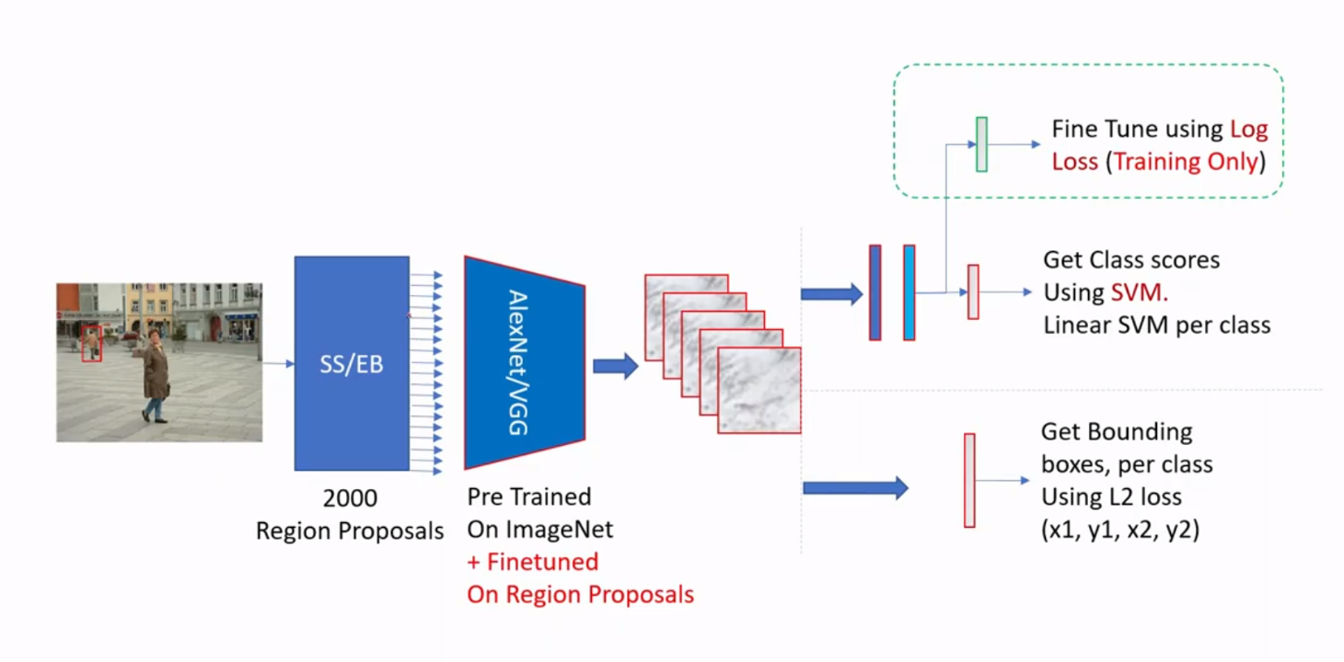
O
B
J
E
C
T
D
E
T
E
C
T
I
O
N
R-CNN

Slide 12
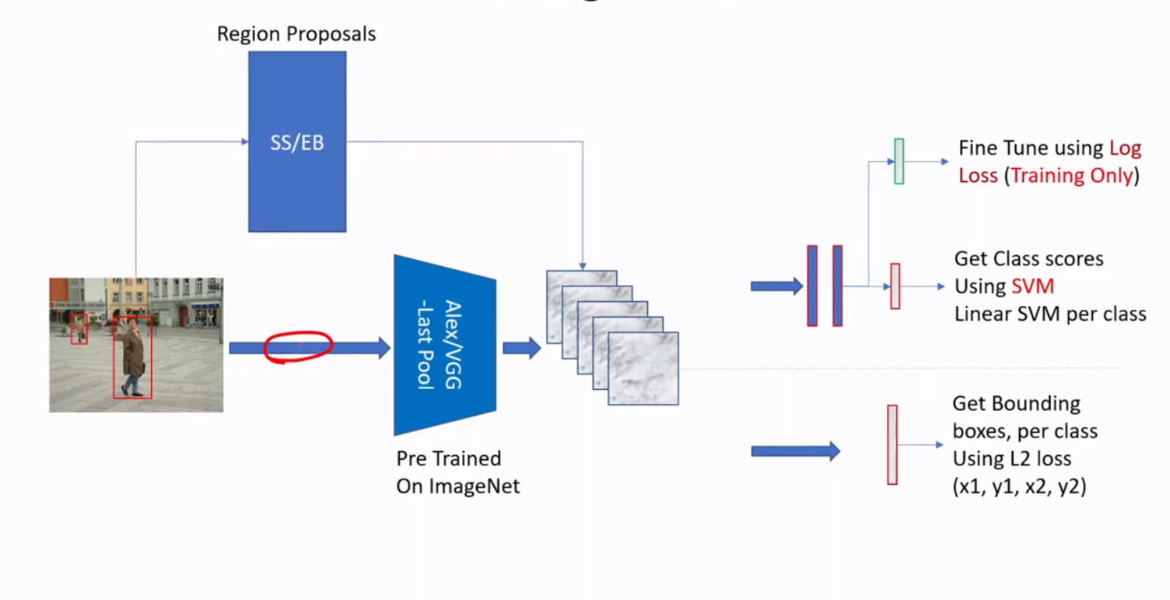
O
B
J
E
C
T
D
E
T
E
C
T
I
O
N
Spp-net Model
Stage 2
S
P
P
-
N
E
T
Softmax Scores
Stage 1
Stage 3

Slide 13
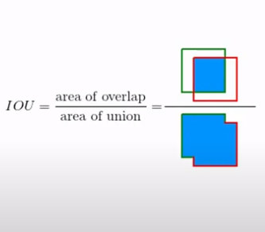
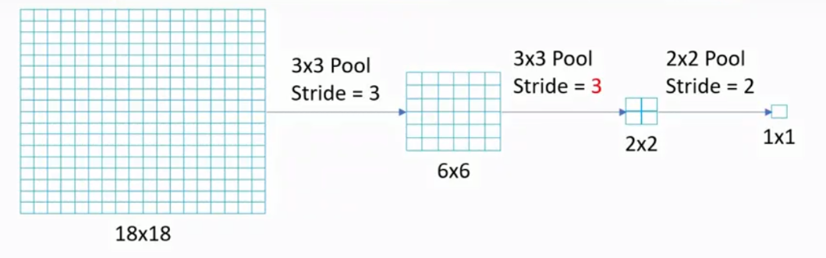
O
B
J
E
C
T
D
E
T
E
C
T
I
O
N
Implementation Details
We used Cv2 selective search algorithm for region proposals.
IOU was used to find expected class for each region proposals and No. of classes increased from 20 to 21 (1 extra for background).
Performed sub-sampling to map coordinates of regional proposals(of scale 224x224) on feature map of (13x13 scale)

Slide 14
O
B
J
E
C
T
D
E
T
E
C
T
I
O
N
Implementation Details
Problems faced:
A lot of region proposals after sub-sampling have size of order 1x3,2x3 etc. which made applying even lower order pooling (2x2) irrelevant.
2. A lot of negative samples (‘Background’) got introduced which made the data highly skewed toward background.
Solution:
1. We made a trade-off between no. of proposals and levels of pooling. We applied only 3 level pooling 1x1,2x2,4x4 and constrained the size of region proposals so that at least 4x4 pooling is applicable
2. Initially we kept IOU threshold to detect object of 0.6 and if not 0.6 then it would be declared as Background. But afterward, we introduced a threshold of 0.3 to detect as background and 0.6 to detect object and limited no. of background proposals to 30/image.

Slide 15
O
B
J
E
C
T
D
E
T
E
C
T
I
O
N
Model Training
1. Obtaining region proposals for each image using selective search algorithm.
2. Passing region proposals through previously trained model to obtain feature maps.
1.Find sub-sampled feature maps corresponding to each region proposals and apply multi-level pooling.
2. Train model to classify each region proposal
1. Apply Bounding Box regression to tighten bounding box for region proposals .
2. Apply Non-Max suppression to remove multiple Bbox for an object

Slide 16
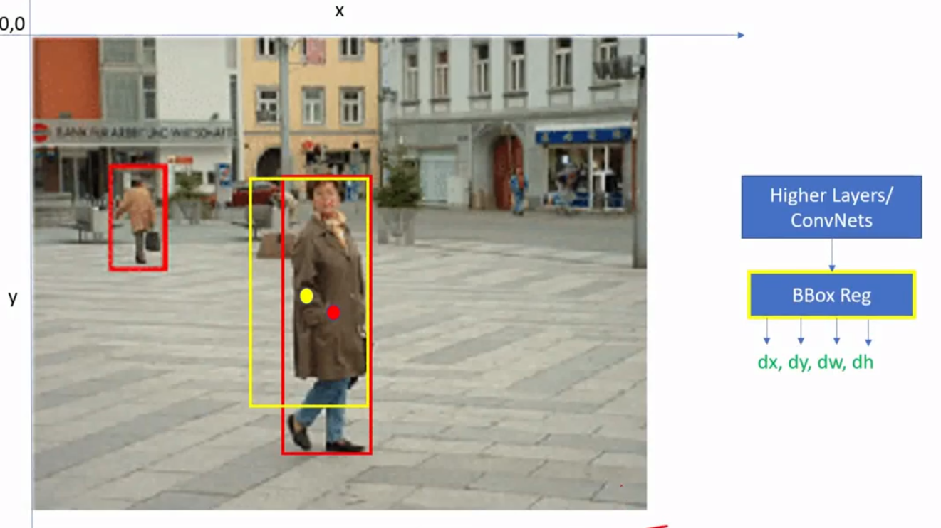
O
B
J
E
C
T
D
E
T
E
C
T
I
O
N
BBox regression
In stage 3, We trained Bbox regressor with inputs feature maps for output of change in coordinates.
Loss function used was L1 because L2 loss was huge and facing difficulty in convergence.

Slide 17
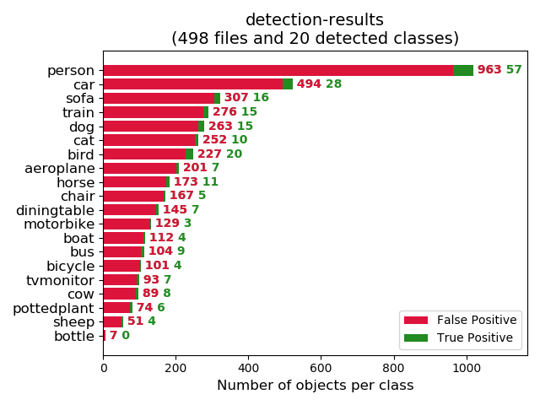
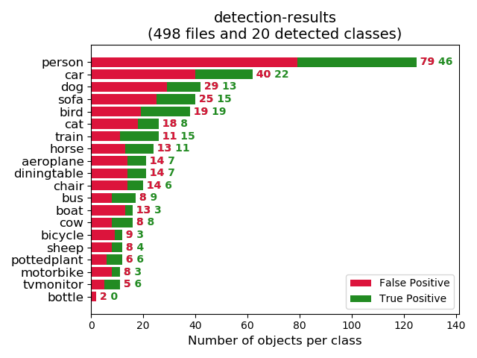
O
B
J
E
C
T
D
E
T
E
C
T
I
O
N
Results
Model | mAP
SPP ftcc(without NMS) | 2.54%
SPP Bbox(with NMS) | 10.37%
Fig-1: Large number of false positives because of lack of NMS
Fig-2: False positives reduced after NMS

Slide 18
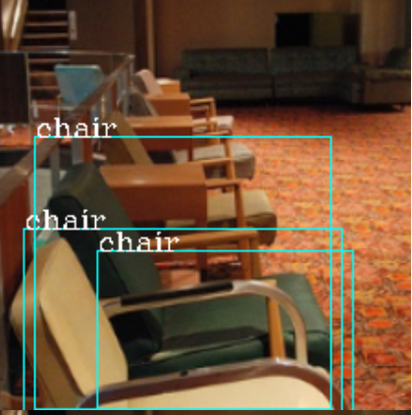

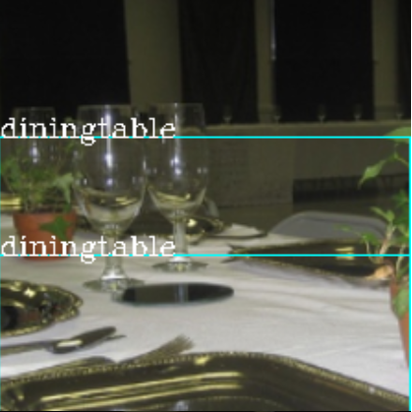
O
B
J
E
C
T
D
E
T
E
C
T
I
O
N
Results
Fig-1: All objects correctly classified
Fig-2: No objects identified at all in the image
Fig-3: Multiple BBox for one object

Slide 19
Limitations
Objects of size less than 70x70 dimensions were ignored while training object detection model.
Size of images used for object detection was 224x224. Due to small size , region proposed for a particular image were around only 200 which is 10 times less than used in paper.
Number of images used for training object detection model is 10 times less as compared to original dataset because of computational limits of colab .

